Slide 1
CCEB/ Department of Biostatistics, Epidemiology and Informatics
Business Office Staff / Administrative Staff
Quarterly Meeting
October 24, 2017

Slide 2
Agenda
New Faculty Members / Senior Scholars and Staff
Staff Life Committee
Spotlight
Overview of DBEI / CCEB Intranet
Business Office Updates
Operational Issues

Slide 3
New Faculty & Staff Biostatistics Division
Faculty:
None
Staff:
Melissa Martin (Shinohara)
Post-docs:
Ji Hwan Oh (Long)
Abdhi Sarker (Shinohara)

Slide 4
New Faculty & Staff Epidemiology Division
Faculty:
None
Staff:
Sue White (as of 11/1/17)
Adam Hawkins (Lewis)
Julia Orchinik (Glanz)
Post-docs:
Takahiro Imaizumi (Feldman)
Botshelo Kgwaadira (Gross)
Seema Lame (Wiebe)
Elizabeth Kaage (Glanz)
Emily Reesey (Lautenbach)
Nianfu Song (Kawut)
Maemo Lasiapeto (Gross)
Precious Moedi (Gross)

Slide 5
New Faculty & Staff Informatics Division
Faculty:
Mary Regina Boland
Li Shen (estimated 1/1/18)
Staff:
Yanzhu Lin (Wang in IBI)
Jake Bergen (Moore)
Rochelle Hambeau-Miller (Hassinger)
Post-docs:
Davy Weissenbacher (Gonzalez)

Slide 6
New Staff Business Office
Staff:
Shawn R. Fenty

Slide 7
Staff Life Committee
Working group who develops ideas and events to improve staff recognition and increase collegiality

Slide 8
Staff Life Committee Members
Currently, there are 11 members on the committee:
Maria Kalai (Co-Chair)
Isaac Rothmiller (Co-Chair)
Sandra Barile
Lisbeth Dennis
Sallie Ellison
Melissa Fernando
Jennifer Kuklinski
The committee meets every other Wednesday to discuss upcoming events
Bridget McCormick
Jennifer Forbes-Nicotera
Janine Pritchard
Lisa Wesby

Slide 9
Staff Life Committee Past Events (Jan 2017 – May 2017)
January 2017 – Cookie bake off
February 2017 – Employee Milestone Recognition for service
March 2017 – Staff Recognition Award (10 lucky winners nominated by their peers won 2 tickets to a 76ers game)
April 2017 – Administrative Professionals week – Pretzel Day, Popsicle Day, Breakfast, Bring your child to work day
May 2017 – Staff Barbeque at Biopond

Slide 10
Staff Life Committee Past Events (June 2017 – Sep 2017)
June 2017 – Chip and Dip event
July 2017 – Staff Happy Hour at Landmark Americana Tap and Grill
September 2017
Adopt a Classroom Project
Cake Pop Decorating Class

Slide 11
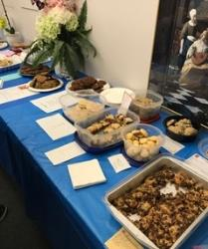
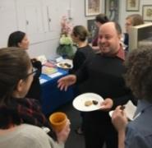
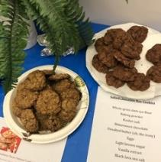
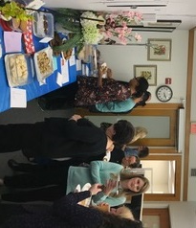
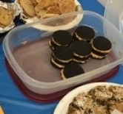
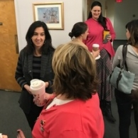
Staff Life Committee Past Event (Cookie Bake Off)

Slide 12
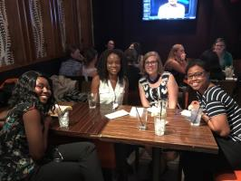
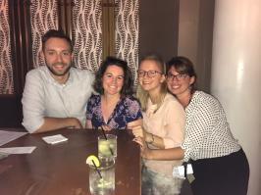
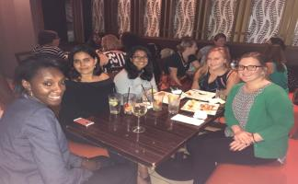
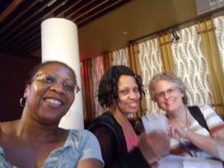
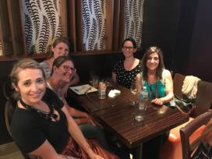
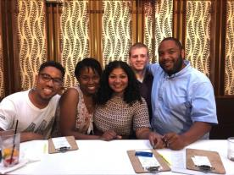
Staff Life Committee Past Event (Happy Hour)

Slide 13
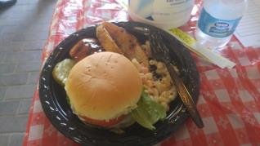
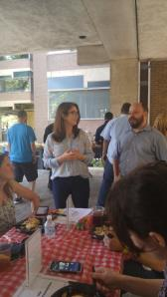
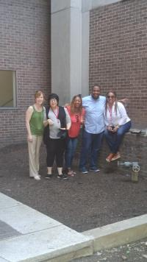
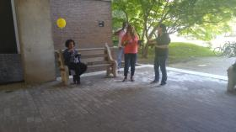
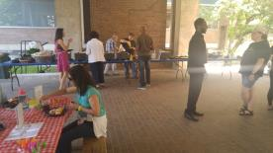
Staff Life Committee Past Event (Summer Barbeque)

Slide 14
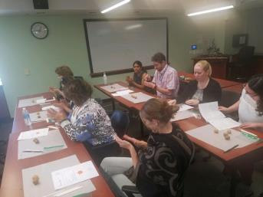
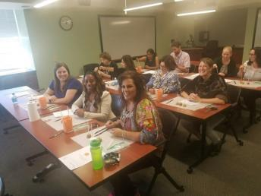
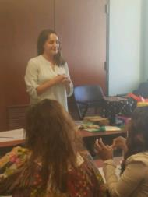
Staff Life Committee Past Event (Cake Pop Class)

Slide 15
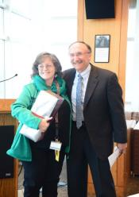
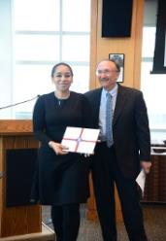
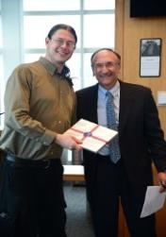
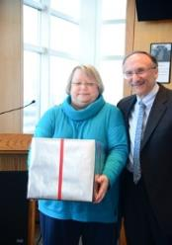
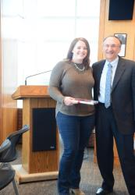
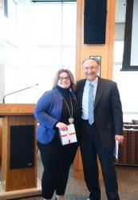
Employee Milestone Recognition

Slide 16
Staff Life Committee Upcoming Events
Oct – Nov 2017 – “Pie in the Sky” (Thanksgiving fundraiser by MANNA). Sampling of pies in business office on November 22, 2017
December 2017 - Holiday Pizza Party & White Elephant gift exchange
January 2018 – Happy Hour weekend before MLK day

Slide 17
Staff Life Committee DBEI / CCEB Intranet
Log onto the CCEB intranet and click on “The Staff Life Committee” tab for a list of fun upcoming events
We encourage staff to submit feedback and any suggestions about how we can help improve your work experience

Slide 18
Spotlight
Jennifer Forbes-Nicotera

Slide 19
Overview of the DBEI-CCEB Intranet
Lisbeth Dennis

Slide 20
Business Office Updates
Supplier Portal Initiative (SPI) aka Change Agent Network (CAN)
Penn is going to implement new automation surrounding
Purchasing request intake (establishing a new vendor)
PO process
Non-PO PDA process (current PDA will be replaced with electronic non-PO payment request
Implementation potentially 7/1/18

Slide 21
Operational Issues
World Travel Reservations
Use Glen Lafferty as the approver in ALL airline reservations. The email approval goes to all staff in 112 Blockley. If you use any other name, you risk lack of approval, and having to re-book at different rates. Spread the word!
Get the expenditure justification or expense approval form to apaycceb@pennmedicine.upenn.edu BEFORE booking. If we have to chase down account numbers or approvals, you risk lack of approval and having to re-book at different rates. Spread the word!
Concur expense reports

Slide 22
Other Business
Our next meeting is pending room scheduling for PSOM spring semester classes. Date/time/location will be announced in January.

