Slide 1
Staff Spotlight: Sarah Green
shgreen@pennmedicine.upenn.edu
Director: Karen Glanz, PhD, MPH
https://www.cceb.med.upenn.edu/chbr

Slide 2
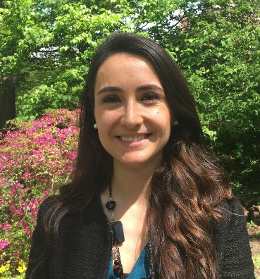
Our Team
Karen Glanz
8th Floor
Jade Avelis
9th Floor
Claudia Caponi
8th Floor
Annie Chung
8th Floor
Yolande Goncalves
8th Floor
Betsy Kaage
8th Floor
Flora Kwong
9th Floor
Bonnie Rubin
8th Floor

Slide 3
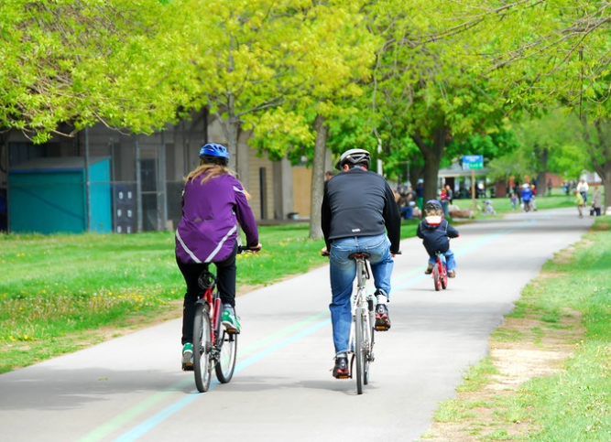
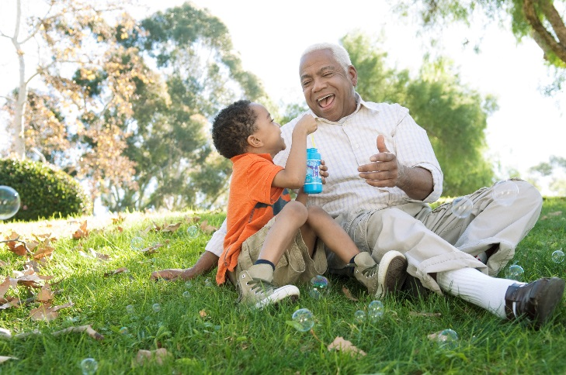
Our Research
Obesity, Nutrition, Physical Activity, Built Environment
Cancer Prevention and Control
Chronic Disease Management and Control
Community Health
Health Communications
Yolande Goncalves
8th Floor

Slide 4
The Impact of Healthy Food Marketing Strategies in Supermarkets
Goal: To increase the sales of healthier target items with implementation of marketing strategies for 18 months in 16 intervention stores in a randomized, controlled trial in disadvantaged neighborhoods in the Philadelphia metro area
Food marketing interventions using the 4 P’s of marketing can increase sales of healthier foods
Product
Price
Placement
Promotion
GRANT ENDED IN AUGUST 2019; COMPLETING DATA ANALYSIS

Slide 5
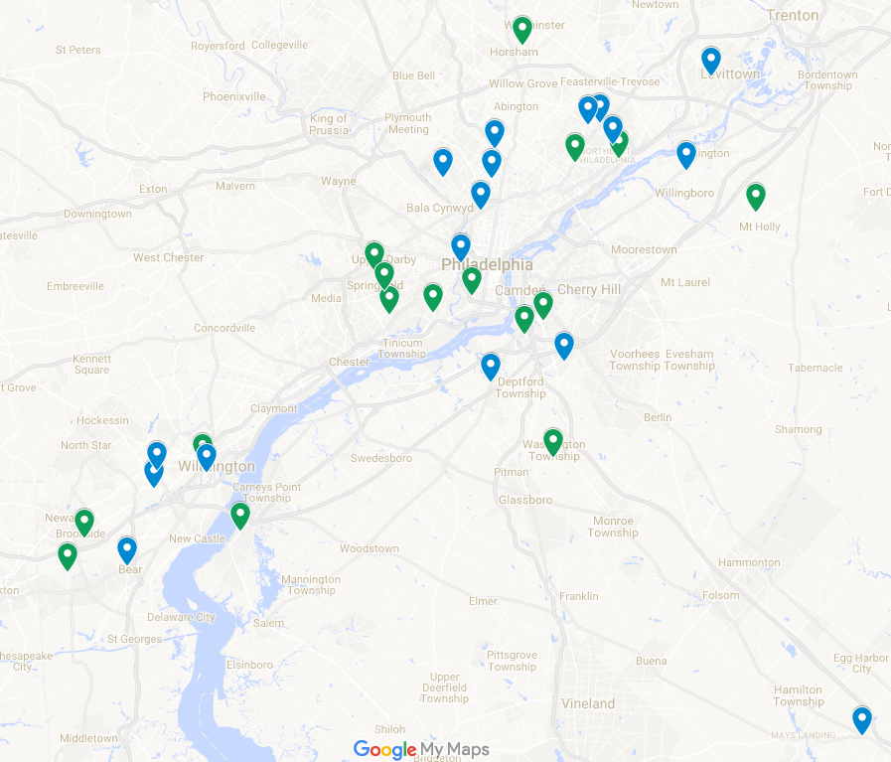
HRS2 Store Map:
Control vs. Intervention Stores
Key:
Control Store
Intervention Store
Notes:
Here is a snapshot of the 33 enrolled supermarkets in our study, all within 50 miles of Philadelphia and all serving disadvantaged communities. The control stores are shown by blue markers and the intervention are green.

Slide 6
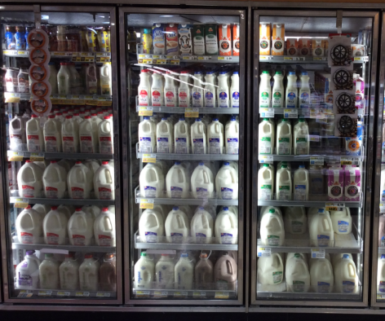
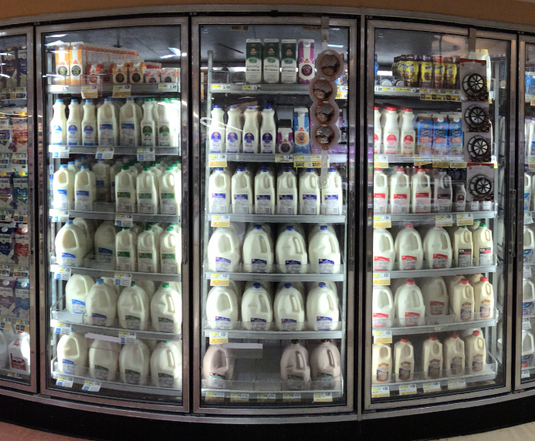
Implemented Intervention - Milk
Target Product:
Lower Fat Milk (Skim, 1%, 2%)
Pre-Intervention:
Intervention:
Notes:
Next I’m going to briefly flip through some examples of pre- and post-implementation photos to show how the Placement strategies of intervention look once in place.
First we have milk. And you’ll see our target products highlighted in green in both photos, and our comparison products in red.

Slide 7
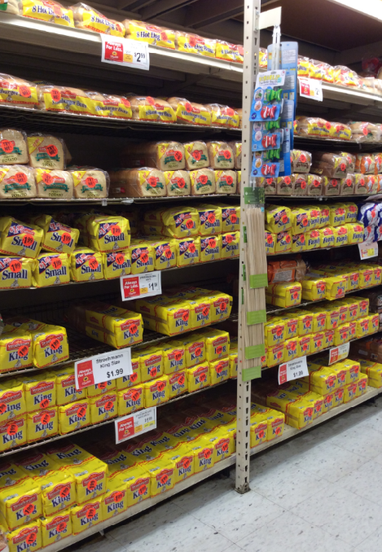
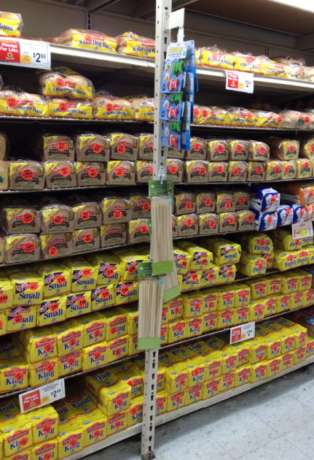
Target Product:
100% Whole Wheat Bread
Implemented Intervention - Bread
Pre-Intervention:
Intervention:
Notes:
And lastly, as a final example, we have an example of sliced bread.

Slide 8
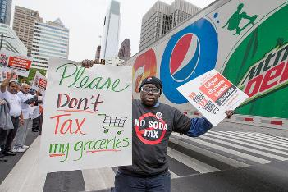
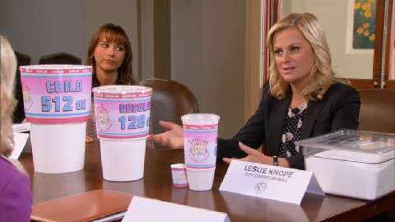
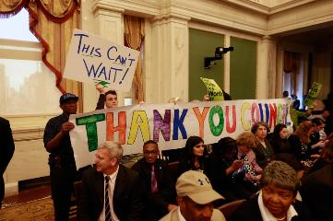
Availability and price of beverages in Philadelphia and the surrounding area before the 2017 Philadelphia Beverage Tax
Goal: To evaluate the availability and price of beverages in Philadelphia and two adjacent counties before the enactment of the Philadelphia Beverage Tax.
Evaluated beverages in 130 stores and 135 restaurants in Philadelphia, Montgomery, and Delaware counties in August and September 2016 and then again in January 2017, after the beverage tax went into affect.
EXPLORATORY RESEARCH, NOT GRANT FUNDED

Slide 9
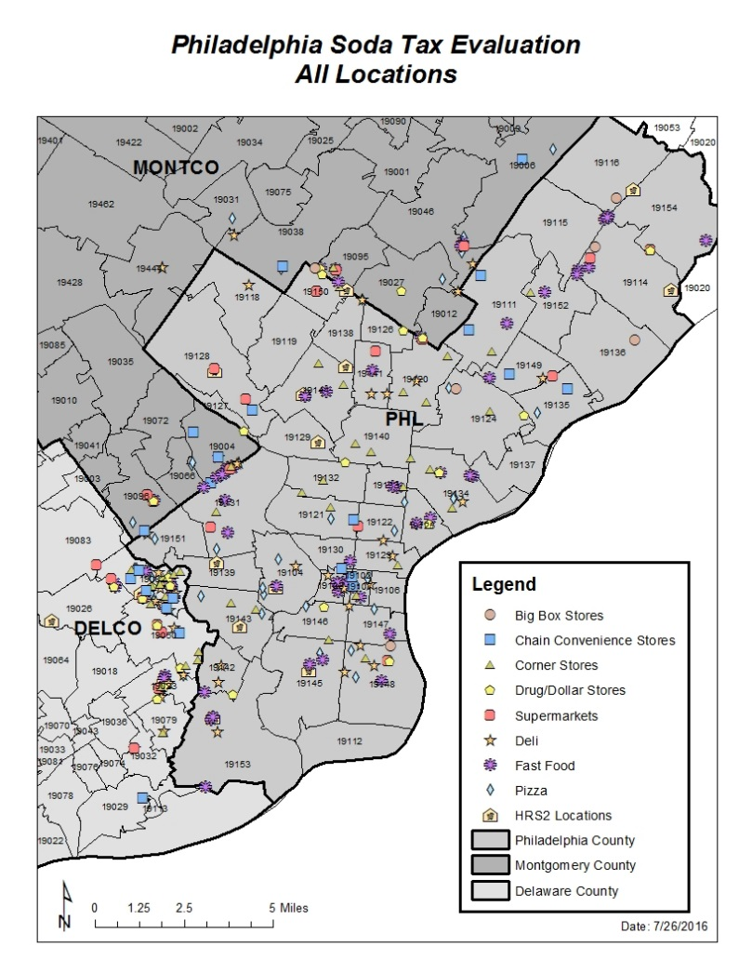

Slide 10
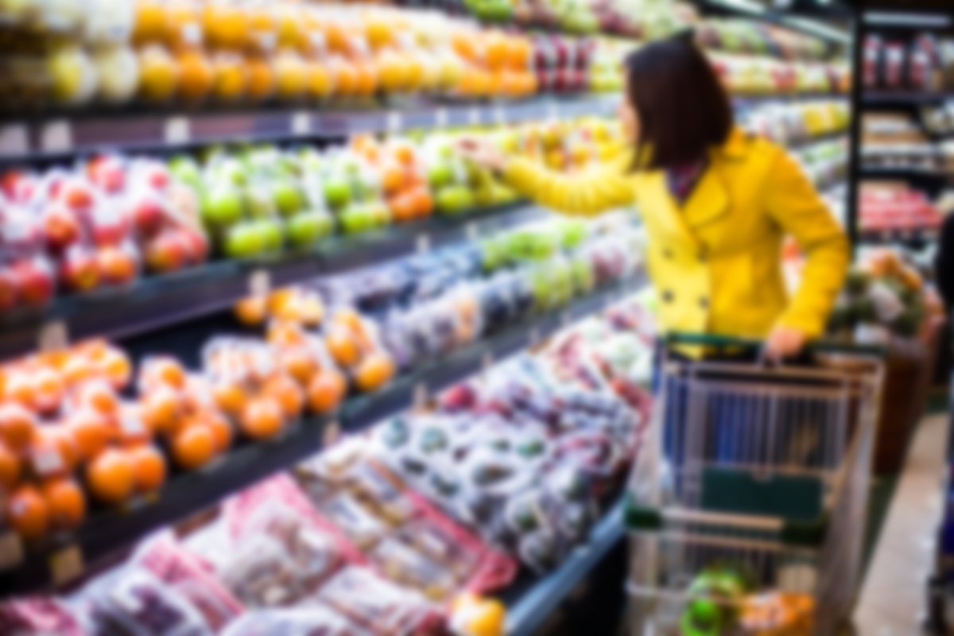
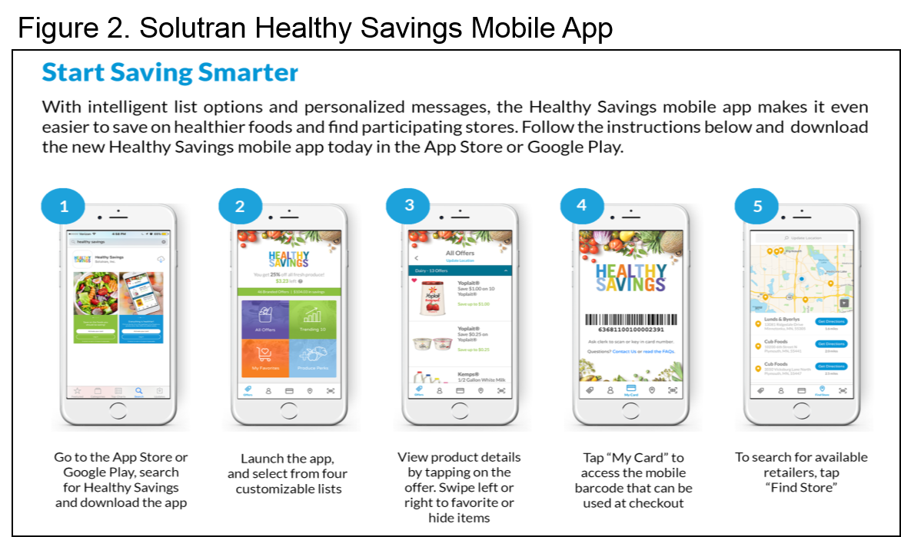
Impact of Real-Time Incentives on Fruit and Vegetable Purchases and Diet
The goal of this study is to evaluate the effectiveness of financial incentives (50% off, up to $10 a week) delivered in real-time at the point of purchase, on the purchase and consumption of fruits and vegetables.
START UP & FORMATIVE RESEARCH NOW; RECRUITMENT BEGINNING IN JANUARY 2020

Slide 11
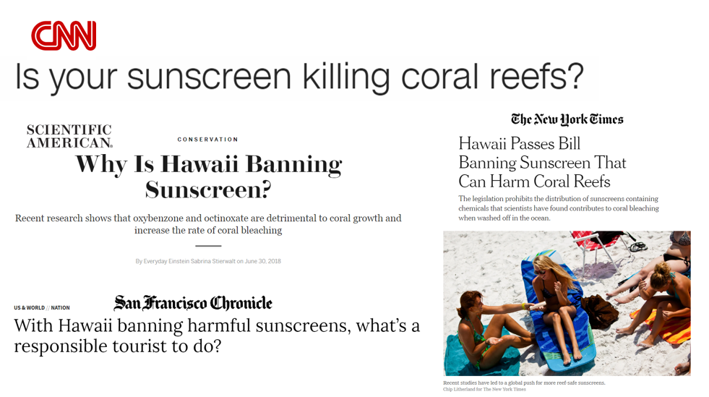
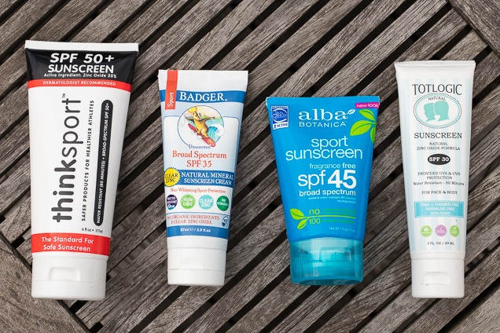
Evaluating a Ban of Common Sunscreen Ingredients in Hawaii: Behavioral, Consumer, and Marine Environment Perspectives
In May 2018, the Hawai’i State Legislature passed a law banning the sale and distribution of sunscreens containing oxybenzone or octinoxate in the state and the law will go into effect in January 2021.
This study is a natural experiment that will examine how a new state law affects skin cancer prevention behaviors, the consumer product environment, and the marine ecosystem.
PENDING; GRANT UNDER REVIEW

Slide 12
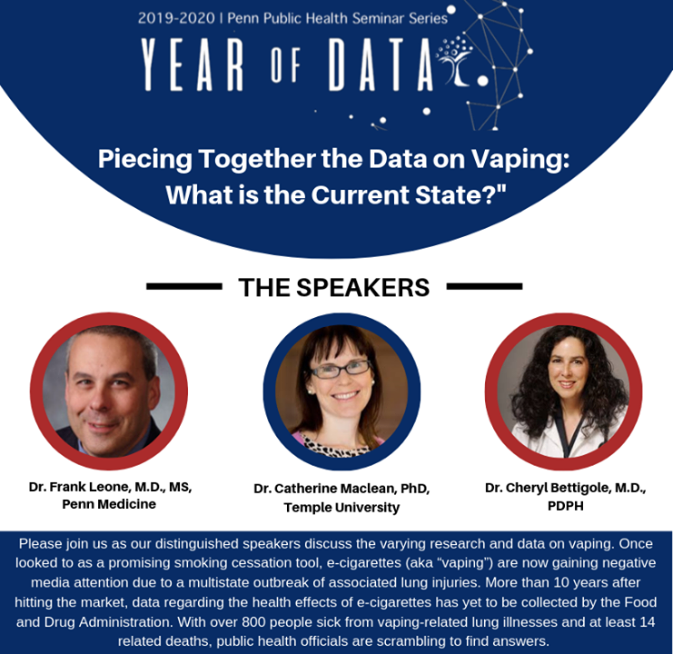
October 30th from 12-1:30pm
BRB, Gaulton Auditorium
Register Here:
https://vapingseminar.Eventbrite.com/

