Slide 1
CCEB/Department of Biostatistics, Epidemiology and Informatics
Business Office Staff / Administrative Staff
Quarterly meeting
June 7, 2018

Slide 2
Agenda
New Faculty Members/Senior Scholars and Staff
Office of the Chair
Staff Life Committee
Business Office updates
Operational issues

Slide 3
New faculty and staff, Biostatistics Division
Faculty: Jing Huang, PhD (starting 9/1/18)
Staff: Carly O’Donnell, Shinohara
Post-docs: Kyunghee Han, PhD (Shaw; 7/1/18) Siliang Gong, PhD (Q. Long; 7/1/18) Sai Li, PhD (H. Li; 7/1/18)
Departing: Faculty – Jason Roy, PhD (6/30/18) Staff – Carla Hultman (6/30/18)

Slide 4
New faculty and staff, Epidemiology Division
Business Office Quarterly Update Meeting,
Faculty: Jordana Cohen, MD, MSCE (starting 7/1/2018)
Nwamaka Eneayanya, MD, MPH (starting 7/1/2018)
Kelly Getz, PhD, MPH (starting 7/1/2018)
Staff: Erik Clarke, Lautenbach
Ashley Woodards, Goldberg
Post-docs: None
Departing: Faculty – Amanda Hyre Anderson, PhD, MPH (6/30/18)

Slide 5
New faculty and staff, Informatics Division
Business Office Quarterly Update Meeting,
Faculty: None
Staff: Avantika Diwadkar, Himes
Michael Stauffer, Moore
Xuequing Lu, Wang
Post-doc: Sija Huang, Moore

Slide 6
Staff, Business Office
Staff:
Linda Brown’s last day was 5/31/18
Donna Duca is on FMLA; return is TBD
Merceda Reale is on PTO 7/17 through 7/25/18, 8/3 through 8/7/18 (tentative) and 8/13 through 8/24/18

Slide 7
Office of the Chair
Staff changes
Research Day recap
Summer Hours
SALINC process
Intranet: Reminder to login to see updated information including Staff-Life Committee events. Also, feedback and suggestions are welcome about how we can improve your work experience

Slide 8
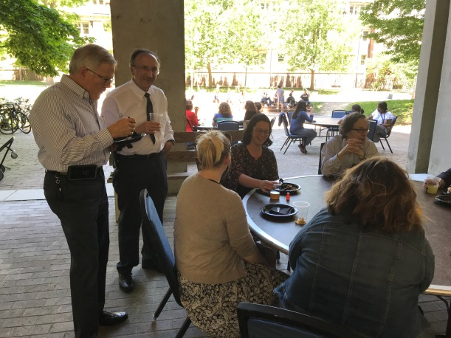
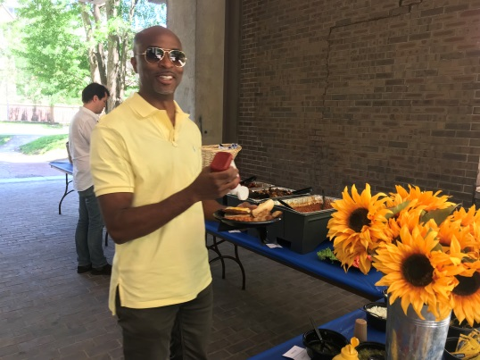
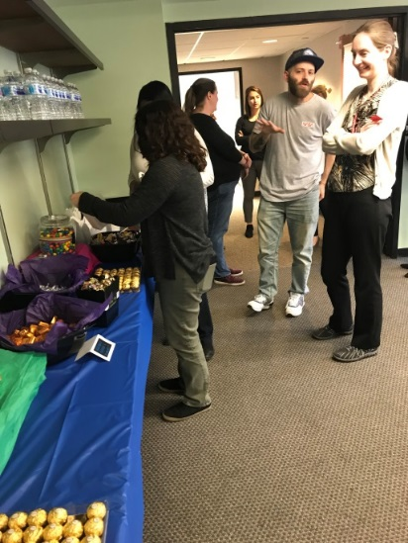
Staff Life Committee
Highlights from Spring 2018:
Administrative Professional’s Week
Hot breakfast
Candy buffet
Pretzel snack break
Raffle basket winners:
Ruth Hong
Qing Liu
Massimo Bigliardo
Sponsored DBEI/CCEB BBQ

Slide 9
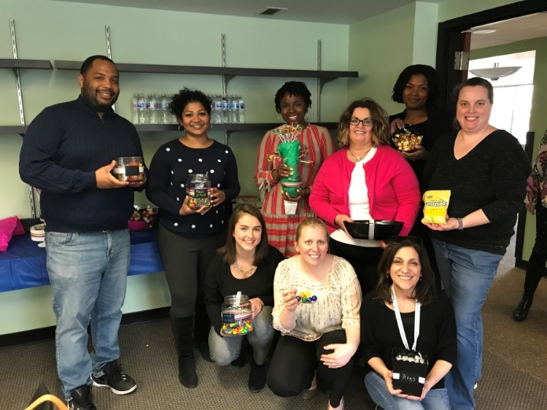
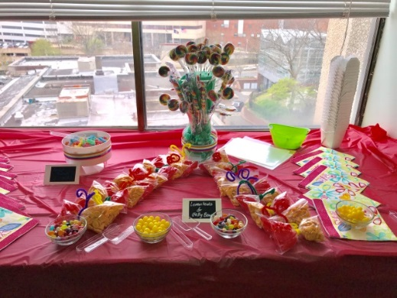
Staff Life Committee
Heading into our second year
Look out for Survey Monkey this summer
Looking for suggestions/feedback
Always appreciate new ideas!
Please let us know if you have not received emails regarding the staff life committee events

Slide 10
Business Office updates
Marketplace Enhancements implemented 4/16/18:
Establishing a new vendor
Non-PO payment request
How’s it working from your perspective?

Slide 11
Business Office updates
Limited Engagement and Independent Contractor process changed, partially, as a result of PME
Limited Engagements: Independent Contractors:
Guest Speakers/Lecturers No employment relationship
DSMB members
Advisory board members

Slide 12
Business Office updates
Limited Engagement and Independent Contractor process changed, partially, as a result of PME
Before service begins for Limited Engagement:
You complete a Limited Engagement Agreement, get signed by the service provider.
You complete an on-line Request New Supplier form in the Penn Marketplace
Supplier receives system-generated correspondence with instructions for answering questions via an on-line form; uploading tax forms
Purchasing gets system-generated correspondence when supplier has completed survey and uploaded tax form
You receive email from Purchasing when supplier is available.

Slide 13
Business Office updates
Send signed Limited Engagement Agreement to Merceda to obtain Purchasing’s signature
After the service is provided:
Complete a Non-PO Payment Request form in the Penn Marketplace
Attach an invoice
Attach expenditure justification
Attach Limited Engagement Agreement I will have returned with Purchasing’s approval
Attach flier if paying speaker’s fee for lecture/speaking

Slide 14
Operational Issues
World Travel reservations
Use Glen Lafferty as the approver in ALL airline reservations. The email approval goes to all staff in 112 Blockley. If you use any other name, you risk lack of approval, and having to re-book at different rates. Spread the word!
Get the expenditure justification or expense approval form to apaycceb@lists.upenn.edu BEFORE booking. If we have to chase down account numbers or approvals, you risk lack of approval and having to re-book at different rates. Spread the word!
Have all your travelers set default travel approver before booking:
Profile>Profile Settings>Personal Information> Travel Approver> Click blue box >Pop-up box appears > Type all or part: Lafferty>Select Glen Lafferty>SAVE

Slide 15
Operational Issues
Submitting hardcopies of paperwork to the Business Office
No double-sided originals. Many systems scan paperwork, and don’t have capability for scanning double-sided originals.
No staples. Many systems scan paperwork, and don’t have the capability for removing staples.
The Biomedical Library authorization form has space for authorization and embossing for direct-billing purposes. DBEI faculty/staff/students should NOT pay for printing. Get a signature and embossment and keep your money in your pocket. You risk non-reimbursement.
This goes for all purchases across Penn (Bookstore, Computer Connection, Biomedical Library, etc.

Slide 16
Operational Issues – Speaker fees
Limited Engagement Fee: A Limited Engagement Fee is a payment to a non-employee, non-student individual for providing a service of an academic nature, short duration, and/or low dollar amount ($1,000 or less per transaction; $5,000 per year max). This is intended for guest speakers, guest lecturers, artists, performers, writers/editors, board members, critics, preceptors, and mentors meeting the fee guidelines.

Slide 17
Operational Issues - Honoraria
Honorarium (from Procedural Guide for … Limited Engagements)
An Honorarium payment is a gratuitous payment of money or other thing of value to a person for the person’s participation in a usual academic activity for which no fee is legally required. Honorarium payments are provided as a token of appreciation for participation in an activity or event, and not as a contractual obligation to pay for services rendered.
Honorarium (from the Grants Policy Statement)
An Honorarium is unallowable when the primary intent is to confer distinction on, or to symbolize respect, esteem, or admiration for, the recipient of the honorarium. A payment for services rendered, such as a speaker's fee under a conference grant, is allowable.

Slide 18
HONORARIA

Slide 19
Other business
PSOM servers and systems will be unavailable the weekend of 6/29 due to 750+ servers being moved to Lancaster. Be sure to spread the word to all faculty, staff, post-docs, lecturers, scholars, students, and any others who tend to work over weekends.
Biosketches, other support pages, grant-related files, etc.—right before the July 5 deadline; your own folders and files on shared drives, and applications hosted by PSOM/UPHS.

Slide 20
Other business
Our next meeting is scheduled for 9/18/18. Location TBD.

