Slide 1
Purchasing Services Catering, Events, Promotional Items Updated as of May 7, 2019

Slide 2
Table of Contents
Contracts and Purchasing Services
Catering
Hotel/Venues
Alcohol
Promotional Items
Questions

Slide 3
Contracts and Purchasing Services
Purchasing reviews and signs all contracts
Send contracts to sourcing@upenn.edu
Turn around time generally three (3) working days for initial review
Purchasing sends suggested redlines

Slide 4
Catering
Approved caterers list
Adding a caterer and turn around time
Deposits
Purchasing looking for new, local, diverse caterers
Working on general guidelines for caterers
Preferred contracted caterers
Bid Waivers

Slide 5
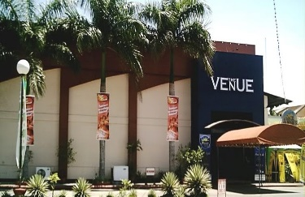
Hotels/Venues
Master Agreements with Philadelphia Hotels
Things we look for and additional terms

Slide 6
Promotional Items & Apparel
Licensed Suppliers
Why?
Bangladesh Accord
Branding Compliance
Pre-Approval
One Time Waivers & Exceptions
Removal of suppliers

Slide 7
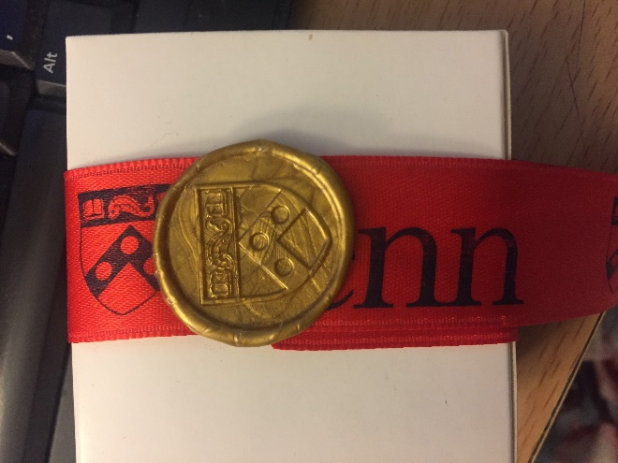
Promotional Items & Apparel
What’s Included?
Logos
Naming

Slide 8
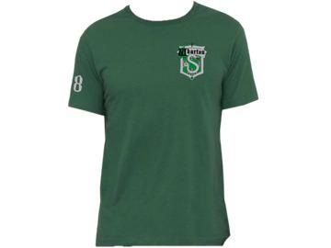
Promotional Items & Apparel

Slide 9
Promotional Items & Apparel
Need help?
Jason Evans
jevans5@upenn.edu

Slide 10
Catering & Events
Need help?
Angela Martyak
amartyak@upenn.edu

Slide 11
Questions?

Slide 12
LINKS
Approved Caterers List
Licensed Suppliers for Promotional Items and Apparel
University Style Guide to Logos Branding and More

